Slide 1
Architecture overview
Pen stroke discriminator
Text
Pen stroke generator
Generated strokes
Generated strokes
z₁
Text image discriminator
Text image generator
Generated image
z₂

Slide 2
Pen stroke GAN
Input: Text, 100-d noise vector z₁(i), i=1..n
Output: a set of n pen points representing a stroke
prev. point
z₁(i)
LSTM
Fully-connected
LSTM
Fully-connected
one-hot
Generator
Discriminator

Slide 3
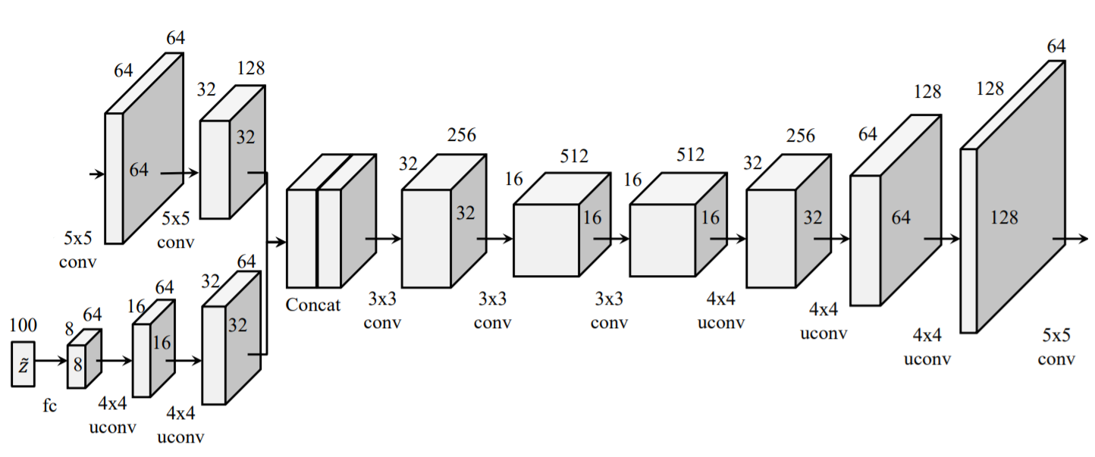
Text image GAN
Input: Generated strokes image Gs(z₁) (128x128x3 image), 100-d noise vector
Output: 128x128x3 image
Gs(z₁)
128x128x3
Generated image
128x128x3

